Slide 1
Presented By: Dr. Meenakshi Gupta

Slide 2
Basic Guide For Using ORCAD Software
Objective:
Familiarize with the basic working environment of ORCAD.
How to draw the circuit & simulate it.
How to view the basic results of simulation.
The necessary precautions to avoid errors.
Also how to recognize the device by label.
Ways of specifying the units and scale factors.

Slide 3
Functions of Mouse
The various actions of left and right mouse
buttons and their functions are given below:
BUTTON ACTION FUNCTION
LEFT Single click Selects an item
Double click Opens the property editor
RIGHT
Single Click Sub Menu on present tool
Selection

Slide 4
PROCESS OF CIRCUIT ANALYSIS
The sequence to be followed for analysis of
any circuit requires a number of steps to be
followed as enumerated below:
Drawing the circuit under capture.
Select the mode of analysis under Pspice menu.
Simulate the circuit under Pspice menu.
Display the results under VIEW menu output.

Slide 5
Opening a New Project
The drawing of circuit is done in capture and requires the
following steps to be followed:
Open a new folder in C:\your group name e.g. ECGroup5.
From START button of windows desktop and go to the Programs and then to Orcad Family Release 9.2 Lite and select Capture.
From the File menu select New Project.
In the dialogue box as shown in fig 1 Name the Project.
Select the Analog and Mixed Circuit Wizard.

Slide 6
Using Browse button give the location as the folder you have opened in C drive with your Group name. Now all projects you will be making and saving will go to this folder. Select OK.
In the next dialogue box as shown in fig. 1 Name the Project.
The blank capture page as shown in fig3 will open. This is the page you will be drawing your circuits. In this page you will see the grid points. If they are not visible you can select them from view menu on selecting grids.
If you are opening an existing project file, the Program Manager will open, where under the file tab you will see. \File name which is the root directory of your Project. Click the + Sign and two folders will open, one of which is Schematic1. Click the + sign of schematic 1 and Page 1 will be seen. Refer Fig4. Click the page 1 box which will open the capture page
You can make the components anchored to grids by selecting from “options” menu “Preferences” “Grid Display” tab and on “Schematic Page Grid” by selecting “ Pointer snap to Grid” selection.

Slide 7
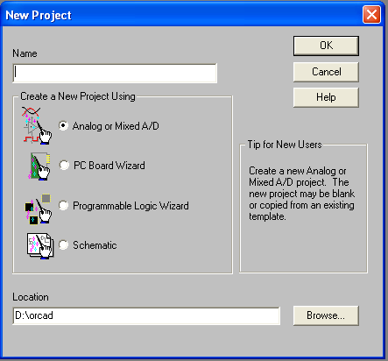
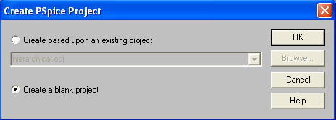
On the right side you will see the “ Tool Palette”. If it is not visible click on the page and it should be visible. Else you can select from “ View” menu “Tool Palette”. Function of each tool can be found by keeping mouse stationary for some time. Learn the name of each tool can be found by keeping mouse stationary for some time. Learn the name of each tool and find the symbol of “Place Part”, Place Wire” and “Place Ground”.
Fig 2.
Fig 1.

Slide 8
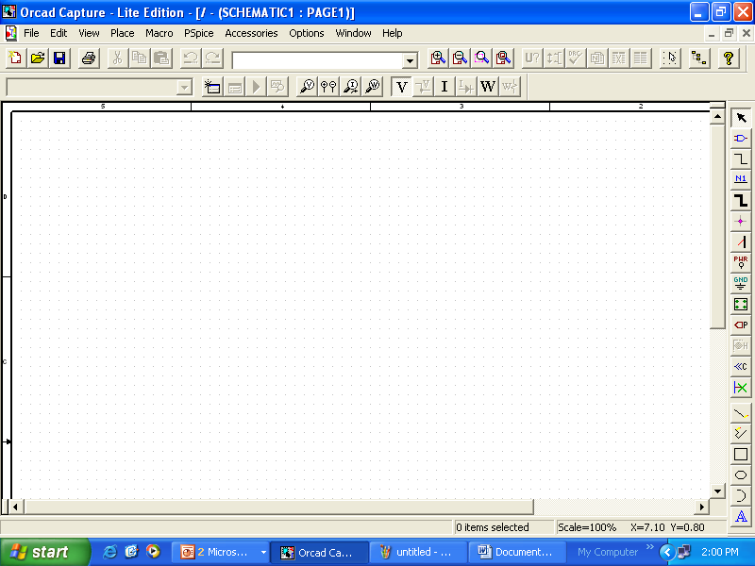
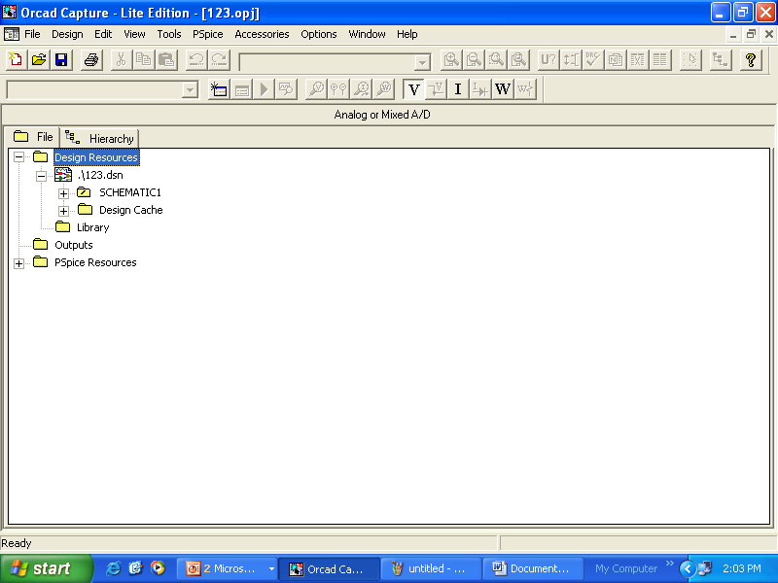
Fig 3.
Fig 4.

Slide 9
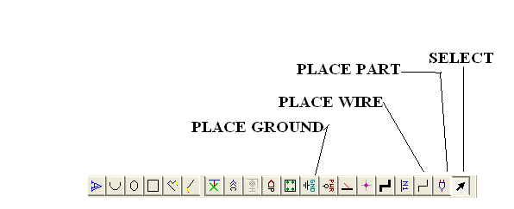
Drawing The Circuit
The drawing the circuit on the schematic page consists of the following steps:-
Place the part on the page using place part tool and selecting the part from any of the selected libraries and selecting OK. Following the same procedure power sources and ground are placed.
Now using Place wire make the connections as per the circuit diagram.
Set the component values and their labels as per the circuit diagram.
Save the Schematic.
NOTE: The Tool Pallete and description of few tools are shown in Fig 5.
Fig 5.

Slide 10
Details of Library
The Pspice libraries contain the active and passive components, power sources and other models. Familiarization with the libraries is a prerequiste before we start working with the simulation. The student version allows a maximum of 10 addressable symbol libraries at a time. It has nine default libraries with extension .olb, the brief description of the symbol libraries you are going to use often are given below:-
analog.olb This library contains analog passive components like R, L, C, coupled inductances and dependent voltage and current sources named as E,F,G and H.
eval.olb This library contains active devices like BJT, JFET, OPAMP, MOSFET (signal and power).
Source.olb It contains ac and dc independent voltage and current sources.
breakout.olb It contains passive and active devices in default configuration. It is useful in circuits where specific models as per circuits are not available.
port.olb It contains ports and pins for specifying node connections without drawing wires. It reduces the complexity of circuits.

Slide 11
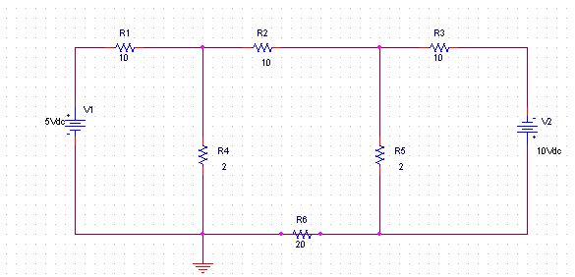
For the beginner the libraries of importance are analog.olb, source.olb,breakout.olb and eval.olb. Students are advised to get acquainted with these libraries. When you select Place Parts and if no library is visible in the dialouge box, one can select Add library and add the libraries from Pspice folder.
Let us draw the circuit diagram as shown below and find the bias points of various nodes. It is assumed that you have already opened a new project in capture and page 1 of schematic 1 is open as shown before. At Fig4.
FIG.6

Slide 12
Select Place Part tool button. From the Analog library select R and select OK. Now you will see the part attached to the cursor. Take the cursor on the capture page, where you want o place the resistance and click the left mouse button. The resistance will be placed with another resistance still attached to the cursor. You can place all the resistances which are horizontal. To place the resistance vertically, select R from keyboard. You will observe that the component gets rotated by 90 degrees anticlockwise. Repeated pressing of R in keyboard rotates the component by 90 degrees. The resistance will be seen with labels and standard value of 1K. After placing all the resistances as per circuit requirement, right click the mouse button and from the sub menu that appears select End Mode.
Next select Place Part, select Sources library and select VDC and place the DC sources with proper orientation as shown in the circuit diagram. You will observe that sources also have the label and the value of 0 volts.
You can also rotate the component by selecting it with left mouse button, keeping the cursor over the component click the right mouse button and select Rotate from the sub menu.

Slide 13
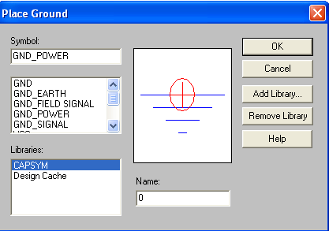
Now select Place Ground tool button. In the next dialogue box select from Capsym library select GND_POWER and change the name box as 0 (zero). You can also double click the ground symbol in schematic and change the name field to 0 in the Property Editor. In case he operating system indicates illegal operation and closes the program then change the name to zero at the time of placing the ground. Refer Fig 7.
NAMING THE GROUND AS ZERO IS ESSENTIAL, OTHERRWISE THE SIMULATION WILL FAIL AND SHOW VARIOUS NODES AS FLOATING NODES SIMULATION ERROR MESSAGES.
FIG.7

Slide 14
The next step is to make the wire connections. This is done by selecting Place Wire tool button. The cursor will change to cross hair. Now place the cross hair at component end and click. Take the cross hair to the other end where you want to make the connection and click again. You will see that the wiring is done. Following the same procedure complete the wiring is done. Do not forget to make the connection of the ground. Now right click the mouse button and select End Mode.
LABELLING AND CHANGING THE VALUE
The resistance value has standard 1K. To change it to the required value, double click 1K and in the dialouge box enter the required value. Continue for rest of the components. In case you need to change the label of components the same procedure is to be followed.
SIMULATION OF THE CIRCUIT
Now we have to simulate the circuit to view the bias point voltages. From Pspice menu select New Simulation Profile.

Slide 15
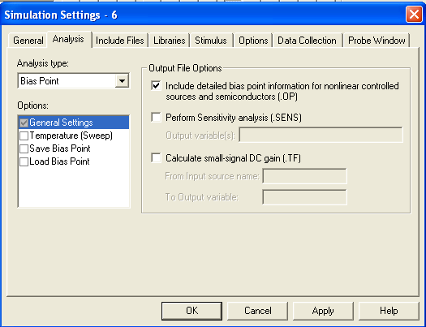
In the dialouge box give a name and select Create button. In the dialouge box. In the Analysis Type select bias points as we want to find the bias voltages of various nodes. In the option box General settings is pre selected. Select OK button. (Refer Fig 8)
From Pspice menu select Run. Alternatively, you can select button from the tool bar .
You will observe the Pspice A/D lite will open automatically showing the progress of simulation. Once the simulation is completed the message will be displayed at the left corner of the window. From View menu select Output File. You will see the output file as shown below:-
FIG.8

Slide 16
**** 08/31/09 08:25:00 ************** PSpice Lite (Mar 2000) *****************
** Profile: "SCHEMATIC1-6" [ D:\orcad\1254-SCHEMATIC1-6.sim ]
**** CIRCUIT DESCRIPTION
******************************************************************************
** Creating circuit file "1254-SCHEMATIC1-6.sim.cir"
** WARNING: THIS AUTOMATICALLY GENERATED FILE MAY BE OVERWRITTEN BY SUBSEQUENT SIMULATIONS
*Libraries:
* Local Libraries :
* From [PSPICE NETLIST] section of C:\Program Files\OrcadLite\PSpice\PSpice.ini file:
.lib "nom.lib"
*Analysis directives:
.PROBE V(*) I(*) W(*) D(*) NOISE(*)
.INC ".\1254-SCHEMATIC1.net"
**** INCLUDING 1254-SCHEMATIC1.net ****
* source 1254
R_R1 N00258 N00288 10
R_R2 N00288 N00340 10
R_R3 N00340 N00367 10
R_R4 0 N00288 2
R_R5 0 N00340 2
V_V1 N00258 0 5Vdc
V_V2 0 N00367 10Vdc
R_R6 0 0 20
**** RESUMING 1254-SCHEMATIC1-6.sim.cir ****
.END
**** 08/31/09 08:25:00 ************** PSpice Lite (Mar 2000) *****************
** Profile: "SCHEMATIC1-6" [ D:\orcad\1254-SCHEMATIC1-6.sim ]
**** SMALL SIGNAL BIAS SOLUTION TEMPERATURE = 27.000 DEG C
NODE VOLTAGE NODE VOLTAGE NODE VOLTAGE NODE VOLTAGE
(N00258) 5.0000 (N00288) .5208 (N00340) -1.3542 (N00367) -10.0000
VOLTAGE SOURCE CURRENTS
NAME CURRENT
V_V1 -4.479E-01
V_V2 -8.646E-01
TOTAL POWER DISSIPATION 1.09E+01 WATTS
JOB CONCLUDED
TOTAL JOB TIME .06

Slide 17
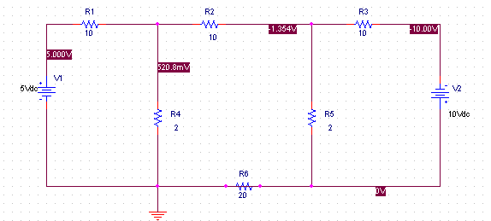
In the Output file, you will see the net list file is included and the circuit file. You will also observe that the simulation has been carried at 27 degree centigrade, a pointer to the fact that value of resistances and other components value will change with temperature. Then the value of node voltages and shown. Lastly, the voltage sources, the current drawn and the power consumed will be displayed. You may not be able to relate the Output file with the circuit exactly now. But acuaintance with it is essential.
For the moment minimize the active window and you will see the circuit page of schematic. In case you are not able to see the bias voltages, from Pspice menu select Bias points and Enable. Repeat again for selecting Enable Bias Point Voltages. Now you will see all the bias voltages.
Go back to the same menu and experiment with enabling bias point currents and bias points power.
FIG. 9

Slide 18
SPECIFYING VALUES AND UNITS
Till now we have worked with simple resistances with ohm values. However, need arises to specify various scales and units for the parts placed in the circuit. Standard floating point notation (X.YYYY E+/-ZZ) are used for specifying the values of components and sources. The results of simulation in the Output file are also displayed in the same format.
Hene 0.625 volt will be shown as 6.25 E-1. The following are the scale suffixes recognize by Pspice:-
Table 1
SCALE SYMBOL SUFFIX VALUE
Fento F 1 E -15
Pico P 1 E -12
Nano N 1 E -09 or 1E-09
Micro U 1 E – 6
Milli M 1 E – 3
Kilo K 1 E 3
Mega MEG 1 E 6
Giga G 1 E 9
Tera T 1 E 12
NOTE Micro is denoted by U and not u
Milli is denoted by M and not m
Mega is denoted by MEG and not M

Slide 19
UNITS
The unit symbols recognized by Pspice for various electrical quantities are as follows:
Table 2
UNIT SYMBOL
Volts V
Amps A
Hertz HZ
Ohm OHM
Henry H
Farad F
Degrees DEG
The scale suffix is followed by unit suffix. Hence 10 microfarad is written as 10UF
Similarly 25 milli volts is written as 25mV and 15 Meg Ohm as 15 MEG or 15 MEGOHM.

Slide 20
NODES
In Pspice any circuit element is identified by two node numbers. The node numbers are assigned by Pspice automatically consisting of alphanumeric strings and they can be viewed in Output file or Netlist file. The format of the node numbers are as follows:-
<Element Name> <Positive Node> <Negative Node> <Value>
Hence a 10K Ohm resistance will be described as
R-R1 $N_0028 $0029 10K
Here R indicate the type of circuit element is resistance, which is reserved letter in Pspice.
R1 is the name of component in circuit, which is assigned by capture automatically. However thi label can be edited…….
Current I assumed to flow from positive node to negative node.
Node 0 is predefined as Ground and must be named 0 when selecting the ground, otherwise simulation error message will be displayed.

Slide 21
IDENTIFICATION OF CIRCUIT ELEMENTS
The circuit elements are identified by first letters in capital which are reserved. The first letter can be followed by letters or numbers or both for easy identification. Hence R1, Rvar, Rpotential 1 are all resistances but could be of different types as defined in the model of the component.

Slide 22
Thanks
Thanks

